Slide 1
Yahtzee
Connor Spinks
Kaori Goto

Slide 2
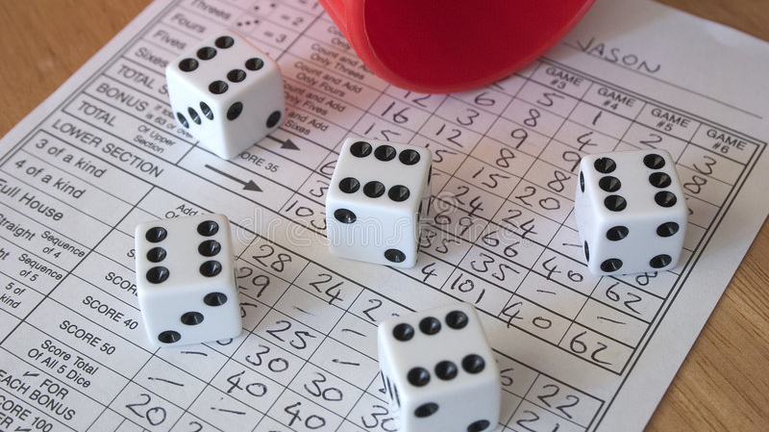
Description
Parts:
5 Dice
Score board
Rules:
Up to 3 dice rolls per turn
Player can choose each slot on score board only once
Upper table
Lower table shows combinations, similar to poker
Once score board is complete, winner is the one with the highest score.

Slide 3
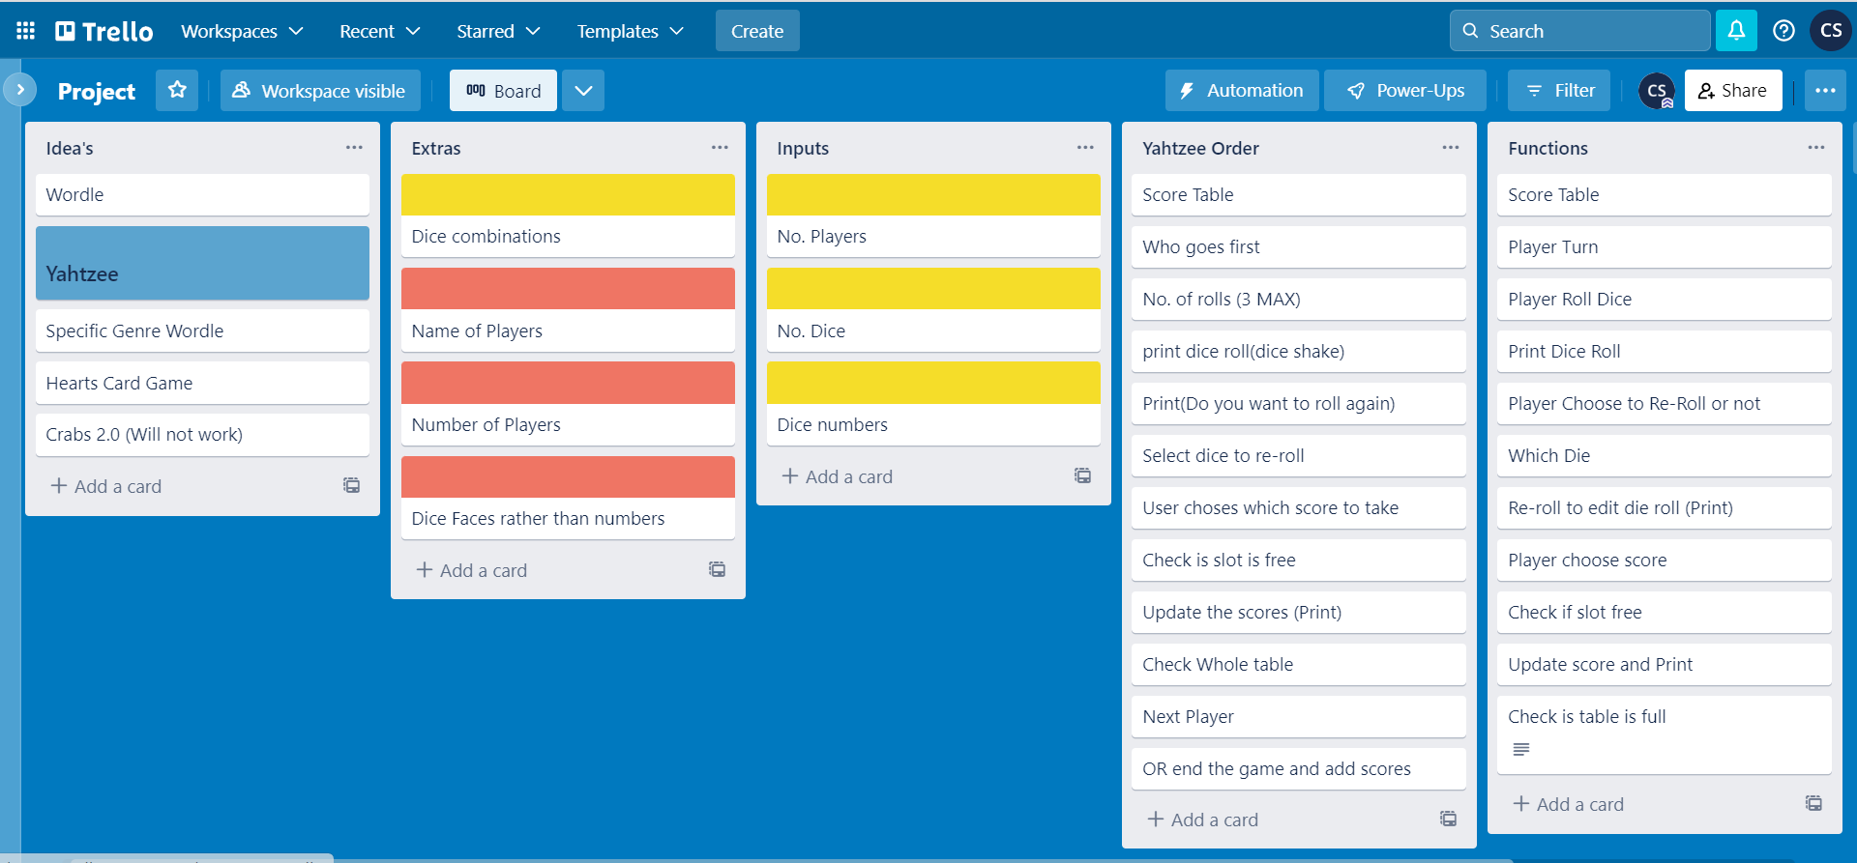
Planning
Trello board

Slide 4
Planning
MVP Version:
2 players
Re-rolls
Upper table (Simple)
New scores can only go to empty slots
Check scores
End Game check
Winner announcement
Final version:
+ Lower table (Combinations)
+ Visual enhancements

Slide 5
Challenges
De-bugging - time consuming
Using boolean outputs effectivly
Using Pandas for our score table

Slide 6
Game Improvements
Users can input their names
Add up to 6 players
Add sequence combinations (eg Small Straight and Large Straight)
Add more combos (eg bonus points)
Visual enhancements (eg. dice faces, Yahtzee animations)
Add an end game/give up option
Add take back option

Slide 7
Code Improvements
Simplify some functions
Re think function structure (How we call and interact with functions)
More steps in logic but simplified to read
Add more discriptive comments to functions and logic for better debugging

Slide 8
Further Code Improvements
Out of rolls function does not work as we intended
Easier to read outputs and prints for players
Clearer instructions for the player

Slide 9
Highlights
Having a working MVP
MVP was fast and well planned out
Initial structure worked quite well which allowed us to discover bugs earlier and improve the code
De-bugging

